Slide 1





Library Management
By: Sheldon Weston, Christopher Scott, and JoAle Hart

Slide 2
Hello!
For our project, the task was to develop a system that manages borrowed books in a library. In our library we had to record the books borrowed by students, be able to see if books were overdue, and search for books by title or author.

Slide 3
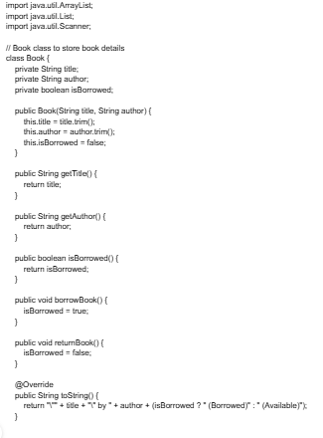
Picture 1
We had to import a String title, author and had to name the public class BOOK
How it works is that each string is public and private. The private strings are the names isBorrowed, getTitle, getAuthor, borrowBook and returnBook in the class along with the private boolean.
The public strings are separated in the public variable and in this code, our job to determine where the book is borrowed from the student and tell the due date, the author, and title of the book.

Slide 4
Explanation
Explain what you did, how it works (walk through)
And why
struggles/ challenges solved

Slide 5
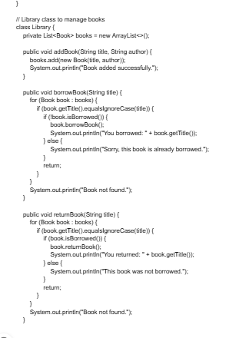



Picture 2
In this part of the code, we had to use the scanner system to determine books being used based on their subject
Next, we examine the name of the author and determine the choice the user inputs for book checkout.
The challenges and struggles I had with this is that I was stuck on the part if the choice being entered by the user will convey the user put if the title matches its curriculum.

Slide 6
Explanation
Explain what you did/ how it works (walk through)
And why
struggles / challenges you solved

Slide 7
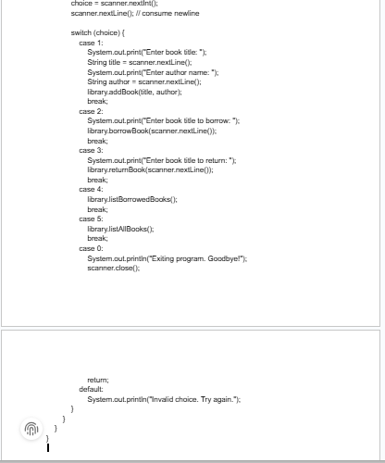
Picture 3
In this next part of the code, we had to determine the book that the student returned and to tell if it is borrowed and who it is borrowed by.
This works when the variable string is involved and naming it returned because we have to check the details of the book for the due date, title, author, and whether the book was borrowed or not.
During this process we will determine if the student’s book was added successfully after the details it was checked on.

Slide 8
Explanation
Explain what you did/ how it works (walk through)
And why
struggles / challenges you solved

Slide 9








Conclusion
Throughout our project we were presented with many strategies to use our critical thinking skills to master our coding and solve problems with our coding techniques. We were able to examine a way to manage books in an organized fashion.

Slide 10
Thank you for your Time!
Are There Questions?

